Slide 1

Data management:
Transparency & reproducibility

Slide 2
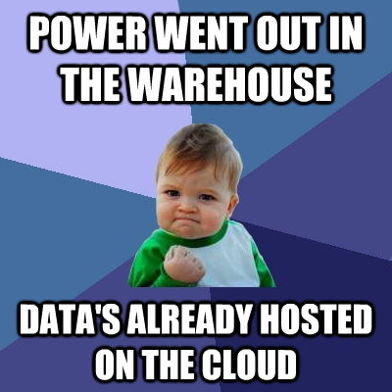
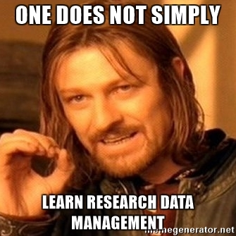

Slide 3
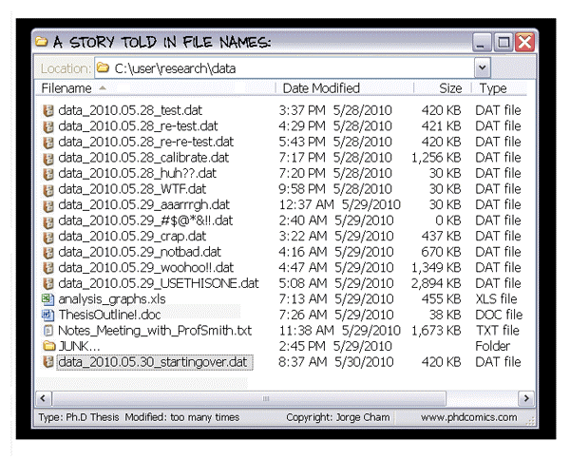

Slide 4


Slide 5
Responsible research conduct: data management/packaging
‘Inadequate record keeping or data management related to research projects’

Slide 6
Responsible research conduct: data management/packaging
‘Inadequate record keeping or data management related to research projects’
  27,5% (Martinson et al., 2005)
  48%! (Godecharle et al., 2017)

Slide 7
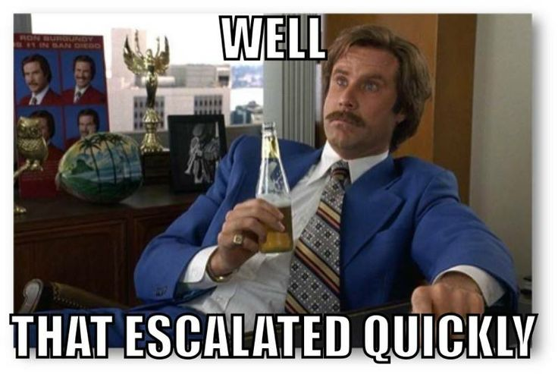
Responsible research conduct: data management/packaging
‘Inadequate record keeping or data management related to research projects’
  27,5% (Martinson et al., 2005)
  48%! (Godecharle et al., 2017)

Slide 8
Responsible research conduct: data management/packaging
Transparency
&
Accountability
Notes:
--> The baseline should always be that data should be shared, except if for some good reason.

Slide 9
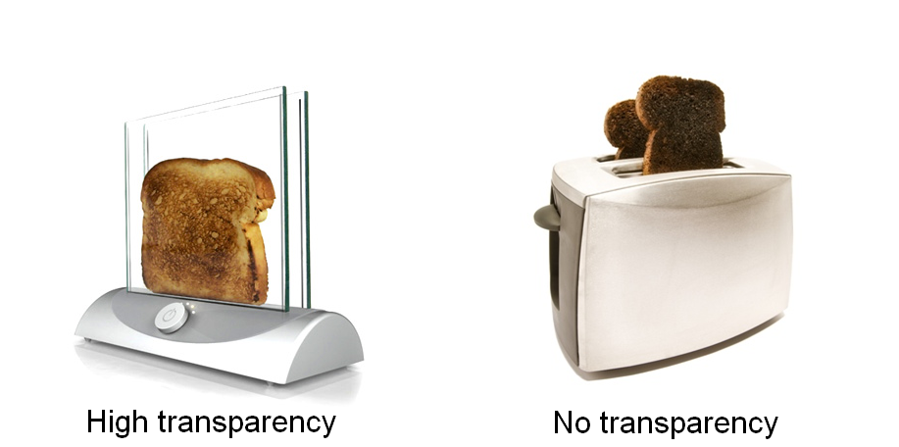
Responsible research conduct: data management/packaging
Transparency
&
Accountability
Notes:
--> The baseline should always be that data should be shared, except if for some good reason.

Slide 10
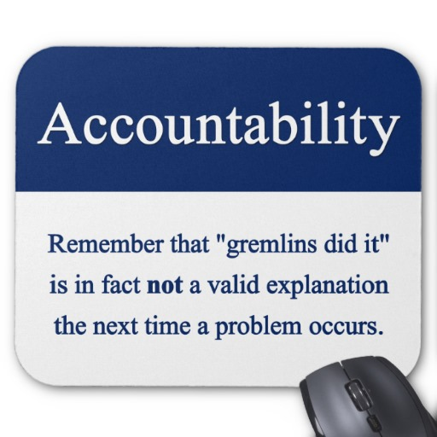
Responsible research conduct: data management/packaging
Transparency
&
Accountability
Notes:
--> The baseline should always be that data should be shared, except if for some good reason.

Slide 11
Say that you wake up one morning with full amnesia related to your current project, but you are still a very capable scientist. Are you able to understand what you did the day before?

Slide 12
How does one achieve T&A?
Today, we’ll focus on three things:
Version control
Preregistration
Reproducibility
Notes:
--> The baseline should always be that data should be shared, except if for some good reason.

Slide 13
A user-friendly platform: OSF
Open Science Framework
Online environment
Version control
Preregistration
Can make files public but not mandatory
Watch out: US servers (privacy!)
More advanced? Github/Bitbucket
Notes:
--> The baseline should always be that data should be shared, except if for some good reason.

Slide 14
How does one achieve T&A?
Version control
=
Track changes for files
Notes:
--> The baseline should always be that data should be shared, except if for some good reason.

Slide 15

‘Normal’ version control
Adapted from Hartgerink (2016): http://bit.ly/chrisPM101

Slide 16
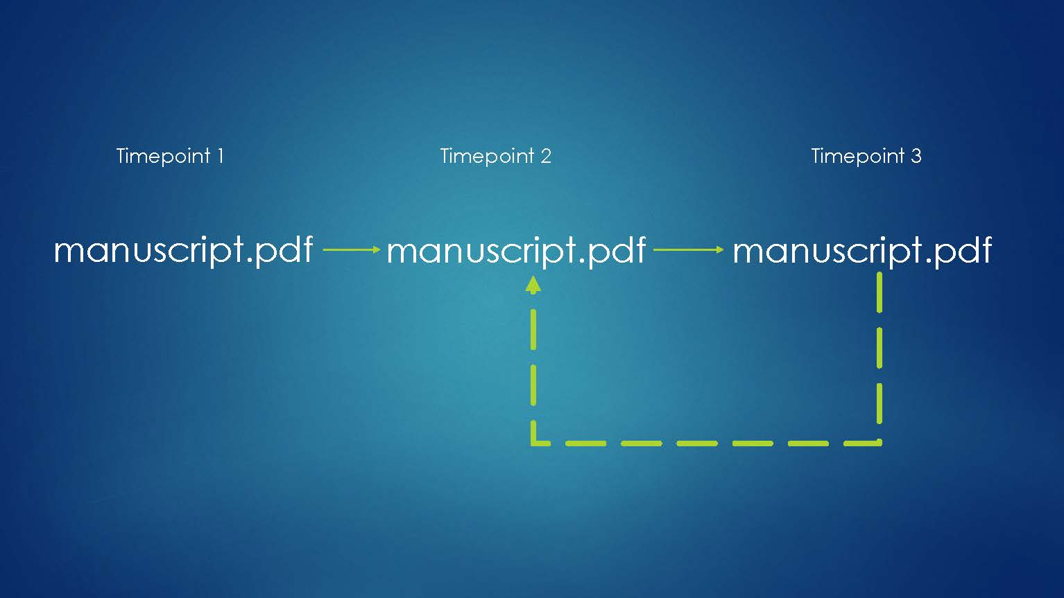
Actual version control
Adapted from Hartgerink (2016): http://bit.ly/chrisPM101

Slide 17
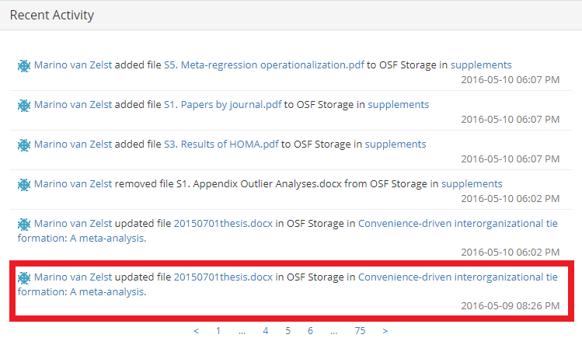

Slide 18
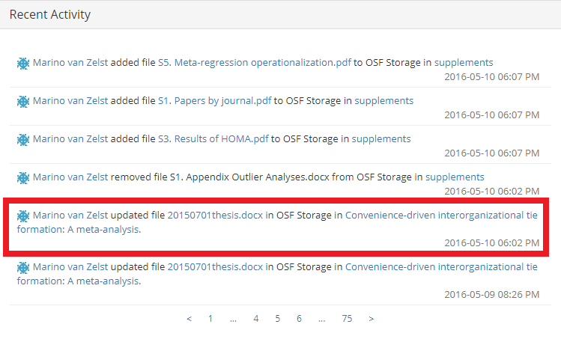

Slide 19
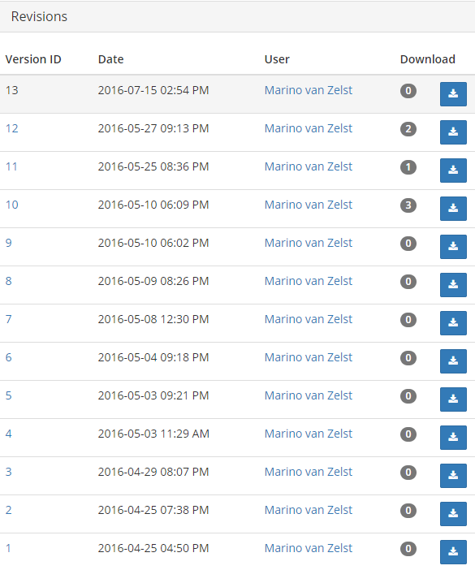

Slide 20
Preregistration
Preregistration limits HARKing which is still practiced a lot (Banks et al., 2016; Bosco et al., 2016)
Publicly register confirmatory and exploratory hypotheses/data collection/analyses/etc.
“In a world of transparent reporting, I choose preregistration as a way to selfishly show off that I predicted the outcome of my study.” (Datacolada.org, 2014)
Notes:
--> The baseline should always be that data should be shared, except if for some good reason.

Slide 21
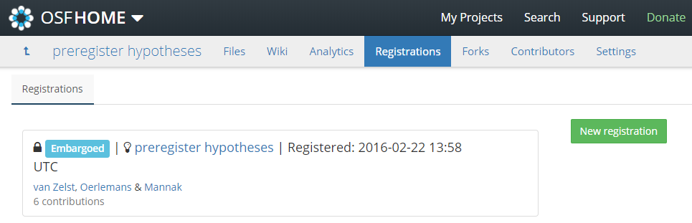
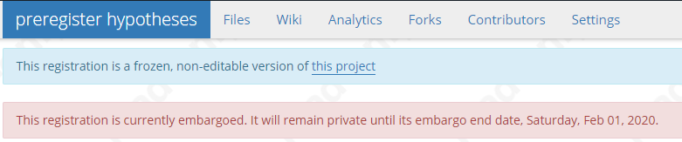

Slide 22
How does one achieve transparency?
Ask ourselves continuously:
Can my future-self or anyone else reproduce this result within a reasonable amount of time?

Slide 23
Reproducibility
Data package requires you to:
Be able to reproduce all your results in reasonable amounts of time
Notes:
--> The baseline should always be that data should be shared, except if for some good reason.

Slide 24
Reproducibility
Data package requires you to:
Be able to reproduce all your results in reasonable amounts of time
Use syntax for everything!
Log WHY you use specific syntax
Notes:
--> The baseline should always be that data should be shared, except if for some good reason.

Slide 25
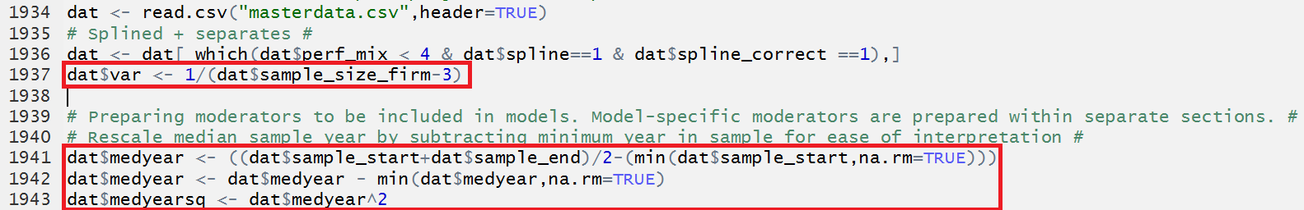
Reproducibility

Slide 26
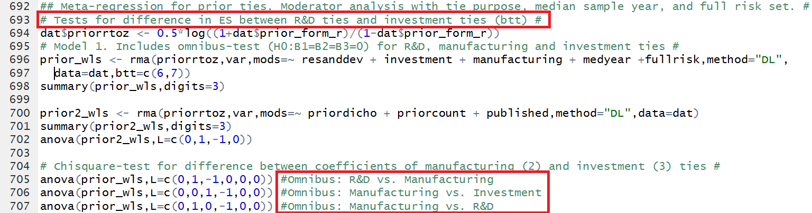

Slide 27
Reproducibility
The future: dynamic documenting
knitR, Rmarkdown
Code: Responses to historical performance feedback are heterogeneous, as the Q-statistic is `r round(all.hpfb_dv$QE,3)` (*p*-value = `r round(all.hpfb_dv$QEp,3)`)
Text: Responses to historical performance feedback are heterogeneous, as the Q-statistic is 392.468 (p-value = 0.003)

Slide 28
1) Will you be capable of reproducing your own results in half a year from now?

Slide 29
1) Will you be capable of reproducing your own results in half a year from now?
2) Will your co-authors be able to do this?

Slide 30
1) Will you be capable of reproducing your own results in half a year from now?
2) Will your co-authors be able to do this?
3) Will a colleague that is not a co-author?

Slide 31
1) Will you be capable of reproducing your own results in half a year from now?
2) Will your co-authors be able to do this?
3) Will a colleague that is not a co-author?
4) An independent researcher who’s
in your field of expertise?

Slide 32
Data audit guidelines https://www.tilburguniversity.edu/research/social-and-behavioral-sciences/download-guideline-datapackage-tsb/
Find me if you want help with making your work (more) transparent and/or reproducible!
J.m.vanzelst@uvt.nl
@mzelst
S6.04

